Slide 1
Intro 1

Slide 2
Chapter Objectives
Identify the key economic activities of South Asia.
Discuss the major environmental and social challenges the region faces.

Slide 3
Living in South Asia
Section 1

Slide 4
Objectives
Explain how agriculture provides a living for most of South Asia’s people.
Describe the role of fisheries and mines in South Asian economies.
Identify where rapid industrial development is taking place in South Asia.
List issues raised by tourism in South Asia.

Slide 5
Terms to Know
cash crop
jute
green revolution
biomass
cottage industry
ecotourism

Slide 6
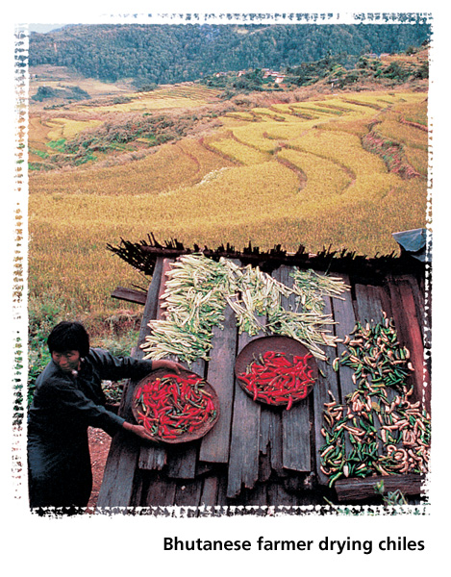
A Geographic View

Slide 7
Geographic Literacy
India’s well-developed transportation system includes over 39,000 miles (62,764 km) of railways, 346 airports, and over two million miles (3,218,000 km) of roads. However, very few individuals own automobiles. People in rural areas also have less access to communications systems than do urban dwellers. Only about 12 percent of India’s population own radios and about 6 percent own television sets.

Slide 8
Living from the Land
Most South Asians are subsistence farmers who grow only what they need for their families. Some South Asians use oxen, water buffalo, yaks, and elephants to pull plows and to haul water and other loads.
Agricultural Conditions In the Himalayan highlands, farmers practice terrace farming on the steep slopes.
Crops include fruit in Pakistan’s valleys and rice in Bangladesh and along most of South Asia’s rivers.

Slide 9
Living from the Land
Sri Lanka’s Plantations Most of India’s farms are small, but huge tea, rubber, and coconut plantations established by Europeans are located in Sri Lanka.
These plantations take up so much land that Sri Lankans must import much of their food.

Slide 10
South Asian Crops
Jute, cotton, tea, rubber, coconuts, bananas, and rice, grown for export, are the major cash crops of South Asia. Other crops include wheat, millet, spices, peanuts, cashews, and sugarcane.
Agricultural Improvements South Asian farmers are beginning to apply new technology to farming.
Modern irrigation, pest control, and fertilization are helping to increase output.

Slide 11
South Asian Crops
The Green Revolution During the 1960s, mechanized farming using new crop varieties sought to increase and diversify crop yields in developing countries.
As a result, India’s wheat and rice production has increased.

Slide 12
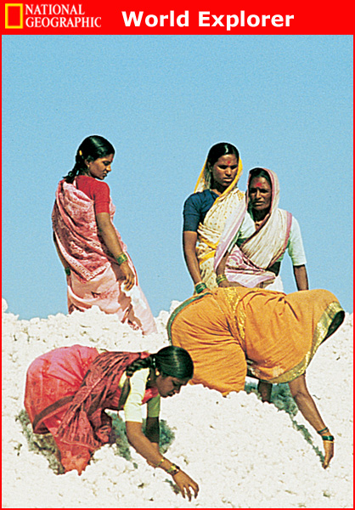
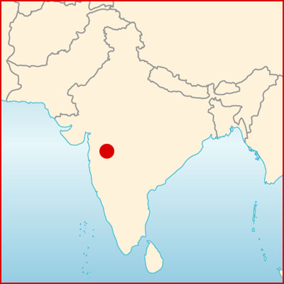
South Asian Crops

Slide 13
Mining and Fishing
Mineral Wealth Iron ore, low-grade coal, bauxite, and copper are mined in India.
Graphite is mined in Sri Lanka.
Pakistan and India have some oil reserves.
Pakistan and Bangladesh have rich natural gas reserves.
Fishing Fish is a staple food in South Asia. Several South Asian countries also export fish.
The Indian government has begun to support deep-sea fishing on a large scale.

Slide 14
South Asian Industries
India’s Evolving Economy After independence India carried out socialist policies that set economic goals and closely regulated private industry.
India’s government also preferred to be economically self-sufficient, discouraging foreign investment.
Short-term success was followed by a slowdown.
During the 1980s, India began welcoming foreign companies and investors.
In 1991, India began moving toward a free market economy.

Slide 15
South Asian Industries
Light Industry Textile production is a major light industry in South Asia.
Thirty-eight million Indians work in the textile industry, producing cotton, silk, and wool fabrics and garments.
Many light industries employ workers in their homes.
These South Asian cottage industries produce fabrics, shoes, jewelry, wood carvings, and pottery.
Mohandas Gandhi, the leader of India’s independence movement, chose the spinning wheel as the symbol of the strength India could draw from its cottage industries.

Slide 16
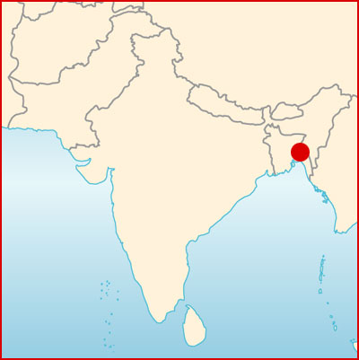
South Asian Industries

Slide 17
South Asian Industries
Heavy Industry Heavy industries in South Asia produce iron, steel, cement, and heavy machinery.
India, Pakistan, and Bangladesh also run a program in which old ships from all over the world are recycled.
The ships are broken down into pieces, and their parts are melted down and forged into new iron and steel.

Slide 18
South Asian Industries
Service Industries More and more South Asians, especially Indians and Pakistanis, work in service industries such as transportation, banking, and administration.
The High-Technology Sector The high-technology industry has grown rapidly in South Asia.
India, for example, is the world’s second-largest exporter of software, earning $5 billion in software trade with the United States in the year 2000.

Slide 19
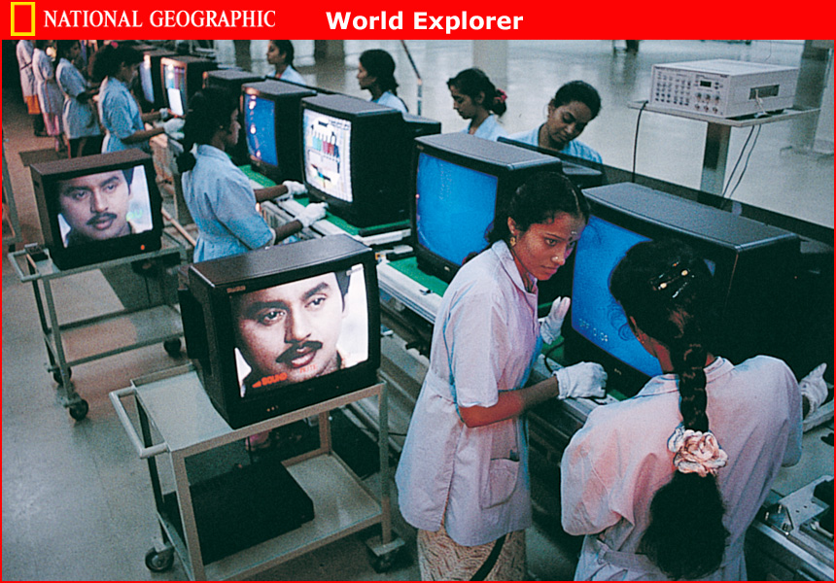
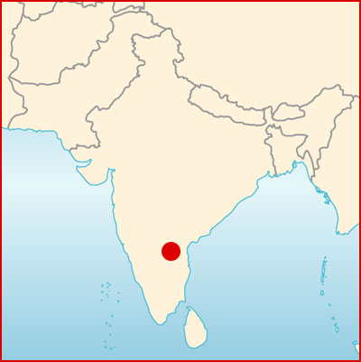
South Asian Industries

Slide 20
Tourism
South Asian countries draw millions of foreign visitors each year.
In recent years, border disputes and ethnic and tribal conflicts have discouraged many tourists from visiting South Asia.
Some countries restrict tourism for environmental or religious reasons.
However, ecotourism, which requires visitors to behave responsibly toward the environment, may be a profitable alternative to such restrictions.

Slide 21
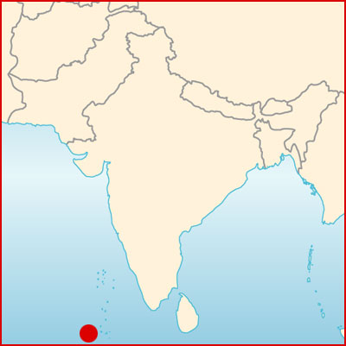
Tourism

Slide 22
People and their Environment
Section 2

Slide 23
Objectives
Examine how South Asia is handling the complex task of managing its rich natural resources.
Describe how seasonal weather patterns present challenges to the region’s economy.
Explain how geographic factors impact the political and economic challenges of South Asia’s future.

Slide 24
Terms to Know
poaching
Chipko
nuclear proliferation
Dalits
sustainable development

Slide 25
A Geographic View

Slide 26
Geographic Literacy
In 1998 India had ten nuclear reactors and another four under construction. Pakistan had only one reactor and was constructing a second. Both countries tested nuclear warheads that same year. The threat of nuclear devastation hangs over continuing conflicts between India and Pakistan.

Slide 27
Managing Natural Resources
Wildlife
South Asia combines high population density with fragile ecosystems.
South Asian countries try to manage their environments by using their resources at a sustainable rate.
Deforestation and irrigation have reduced the habitats of elephants, water buffalo, crocodiles, tigers, and other wild animals.
Governments are creating wildlife reserves and restricting logging in an effort to help preserve the animals.

Slide 28
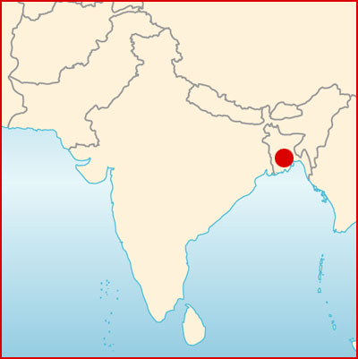
Managing Natural Resources

Slide 29
Managing Natural Resources
Water Much of South Asia’s population has limited access to clean water.
For example, 80 percent of India’s population has no access to sanitation facilities.
Under such conditions, untreated sewage pollutes water supplies that people depend on for normal daily use.

Slide 30
Managing Natural Resources
The Narmada River Dilemma South Asian countries have built dams to provide hydroelectricity and to help areas that suffer from drought.
Dams, however, also trap silt and bacteria and often flood the areas where they are built.
Building a dam across India’s Narmada River would irrigate millions of acres of arid land and provide hydroelectric power.
However, it also would force the removal of nearby farmers from their villages.

Slide 31
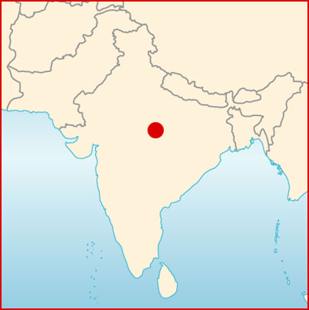
Managing Natural Resources

Slide 32
Managing Natural Resources
Forests Commercial logging has destroyed many of South Asia’s old-growth forests.
Slash-and-burn agriculture also has contributed to the damage.
The loss of forests contributes to higher temperatures, erosion, and loss of agricultural productivity.
Protecting the Forests Reforestation efforts are under way throughout South Asia.
Governments have banned logging in some areas, and people are encouraged to plant more trees.

Slide 33
Seeking Solutions
Scientists are studying ways to combat South Asia’s severe air pollution problem.
Meteorologists using modern technology are working to predict the annual monsoons.
Accuracy in predicting the monsoons will help people protect their property and lives from storm damage.
Many Bengali people live on islands made of layers of silt floating on the surface of coastal water.
In heavy rains these layers break up, and people lose their homes, their possessions, and even their lives.
Studies of this erosion may lead to solutions and help save lives.

Slide 34
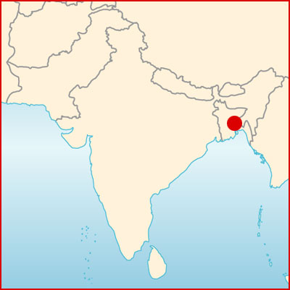
Seeking Solutions

Slide 35
South Asia’s Challenges
Conflict in Kashmir Since 1947, India and Pakistan have fought over control of Kashmir.
Both countries have now developed nuclear weapons, the cost of which has diverted much-needed funding from meeting human needs.
Internal Conflicts Sri Lanka has suffered from internal ethnic conflict.
India also suffers from the legacy of its ancient system of social classes.
People called Dalits, those assigned to the lowest social status, are still denied many opportunities.

Slide 36
Promise and Possibility
South Asia has a history of conflict but also one of tolerance for diversity.
South Asian countries must reconcile their conflicts in order to prosper.

Slide 37
Section 1 – Summary
Agriculture provides a living for most of South Asia’s people, and it also provides cash crops for export.
South Asia’s mines and fisheries contribute to its exports.
South Asia is experiencing rapid growth in the high-tech sector and continues to develop light and heavy industries.
Tourism offers both benefits and challenges to the South Asian economy.

Slide 38
Section 2 – Summary
South Asia faces the complex task of managing its rich and varied natural resources.
South Asia is seeking scientific solutions to its environmental challenges.
Conflict in South Asia stems from issues of nationalism, religion, and ethnicity.

