Slide 1
Intro 1

Slide 2
Chapter Objectives
Describe the governments and economies of the East Asian countries.
Explain the environmental challenges and recurring natural disasters East Asians face and the steps they are taking to meet those challenges.

Slide 3
Living in East Asia
Section 1

Slide 4
Objectives
Discuss the types of governments and economies that East Asian countries have.
Identify the economic activities that play an important role in East Asia.
Describe how other countries in the region are challenging Japan’s economic dominance.
Explain how the countries of East Asia are economically interdependent.

Slide 5
Terms to Know
command system
commune
cooperative
Asia-Pacific Economic Cooperation Group (APEC)
trade surplus
trade deficit
dissident
economic sanctions
World Trade Organization (WTO)
merchant marine

Slide 6
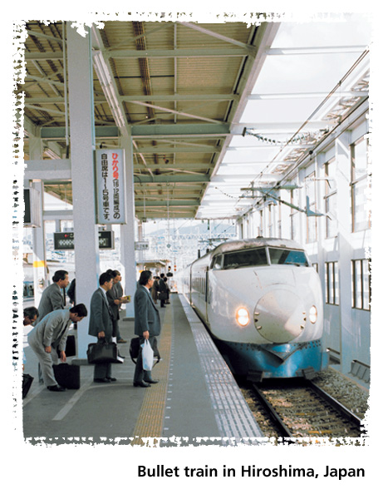
A Geographic View

Slide 7
Geographic Literacy
In spite of its small land area and few natural resources, Japan is the world’s second-largest producer of cars and trucks. In 1998, Japan produced nearly 8 million passenger cars and over 2 million trucks. Japanese-made cars are widely sold in the United States.

Slide 8
Political and Economic Systems
Since the end of World War II, Japan, South Korea, and Taiwan have developed market economies and democratic governments.
All three countries have populations with generally high standards of living.
Communist-ruled China and democratic Mongolia have been moving toward economies that have both command and market features.
North Korea, with one of the world’s few remaining command economies, is less economically developed.

Slide 9
Agriculture
In the past 50 years, most East Asian countries have shifted from rural-based agricultural economies to urban-based industrial economies.
China More than 55 percent of China’s workers farm the land.
China’s chief crops are rice, wheat, and tea.
During the 1950s, the communist government organized farmers into large communes and mandated the farming methods to be used.

Slide 10
Agriculture
The result was widespread famine.
The government now encourages smaller farms, jointly run by households but with private garden plots.
Farmers can sell and profit from any surplus crops or animals.
Many rural workers, however, are moving to cities to take better paying jobs in industry and commerce.

Slide 11
Agriculture
Mongolia Mongolia’s economy depends on the raising of livestock.
The country’s chief products are wool and milk, usually produced on large government-owned farms.
Both herders and farmers are moving toward a market economy.

Slide 12
Agriculture
South and North Korea Only about 14 percent of South Koreans work on small farms.
Modern farming methods have helped make up for this shortage of farmers.
About 40 percent of North Koreans are farmers.
Farms in North Korea are organized into cooperatives worked by households and controlled by the government.
The country, however, cannot meet its own food needs and has accepted food aid from foreign sources.

Slide 13
Agriculture
Japan and Taiwan In Japan, modern farming methods and efficient use of limited space have produced high crop yields.
The Japanese government subsidizes farmers’ incomes, which helps keep farmers in agriculture.
Taiwan grows rice, sugarcane, tea, bananas, and pineapples on its limited farmland.

Slide 14
Industry
Since the 1960s, Japan, South Korea, and Taiwan have become important industrial and trading countries.
China is becoming more industrialized.
North Korea and Mongolia lag behind the other East Asian countries.
Japan With the United States’ help after World War II, Japan rebuilt its economy.
A highly skilled workforce and up-to-date technology have made Japan a leading producer and exporter of motor vehicles, computers, electronics, and other consumer goods.

Slide 15
Industry
South and North Korea Like Japan, South Korea has developed a prosperous market economy based on exports.
North Korea, however, has a command economy based on heavy industries that produce machinery, chemicals, and military equipment.
Since the Soviet collapse in 1991, the North Koreans have slowly moved toward establishing contacts with market-economy countries, especially South Korea.
Taiwan Until the 1960s, Taiwan used profits from agricultural exports to build its manufacturing industries.
Today, technology-based products and services are replacing textiles and plastics as Taiwan’s major exports.

Slide 16
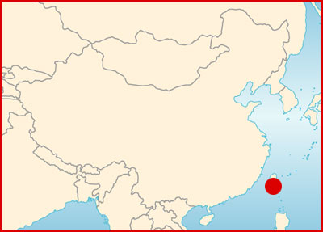
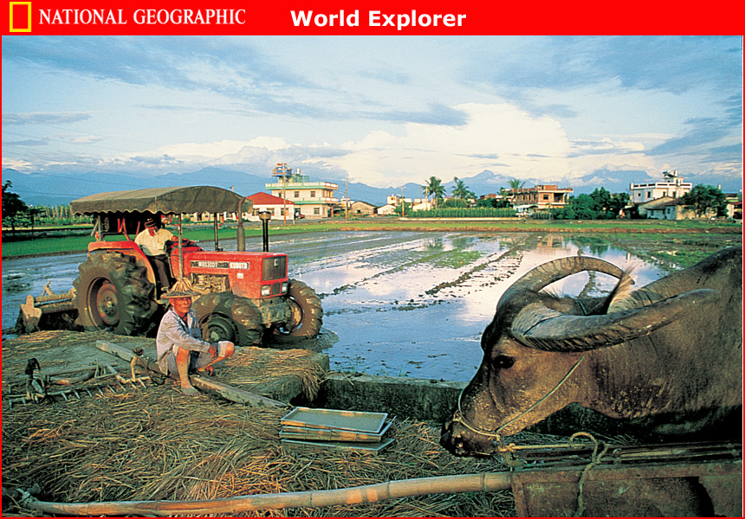
Industry

Slide 17
Industry
China China’s communist government controls its manufacturing industries.
Since the 1970s, however, Chinese officials have sought foreign investment and permitted private ownership of small businesses.
Market reforms have helped China’s economy grow by 8 percent a year.

Slide 18
Industry
Hong Kong and Macau The Chinese territories of Hong Kong and Macau are major trading centers.
The British gave up control of Hong Kong to the Chinese in 1997, and Macau, formerly a Portuguese colony, became a part of China in 1999.
The market economies of both territories bring great profits to China.

Slide 19
Trade
East Asian countries have become more interdependent with one another and the rest of the world. Yet deeply rooted political differences still affect trade and international relations.
Japan: Trade Surpluses Japan must import raw materials from which it makes its export products.
The country enjoys an enormous trade surplus because of the tariffs it places on imported goods.
Japan’s trading partners resent these tariffs and have tried to persuade Japan to lower them to restore a balance of trade.

Slide 20
Trade
China: Trade and Human Rights China actively seeks international trade partners, but many countries disapprove of its treatment of Chinese citizens who speak out against government policies.
As a result, these countries restrict trade with China.
In 2000 the United States granted China full trading privileges, hoping that trade would influence China to respect human rights.

Slide 21
Transportation and Communications
Although every East Asian country has modern air services, overland travel in the region involves long journeys by railroad or highway. Rural transportation and communication networks lag behind those in urban areas.
Land Travel Japan, South Korea, and Taiwan have nationwide highway and rail networks.
By contrast, most of Mongolia’s roads are unpaved, and lack of inland land transport has hindered the development of western China.
The Chinese government, however, has developed railroads for long-distance travel.
Bicycles are a popular form of transportation throughout China.

Slide 22
Transportation and Communications
Water Travel China’s rivers are important routes from the interior to seaports such as Shanghai.
Japan and China both have large merchant marine fleets.
Commercial shipping is important to East Asia’s export trade.

Slide 23
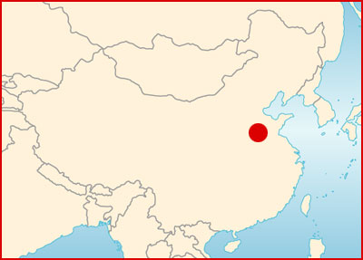
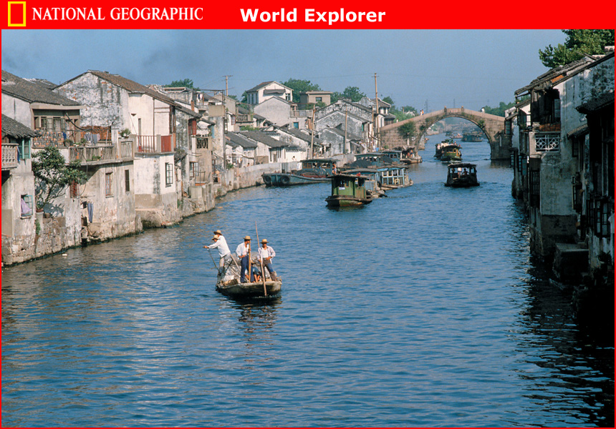
Transportation and Communication

Slide 24
Transportation and Communication
Communications Japanese, Taiwanese, and South Korean citizens enjoy easy access to the Internet and good telephone systems.
Most people own televisions and radios and read print materials of all kinds.
In China and North Korea, the government controls the media and limits citizens’ access to information on the Internet.

Slide 25
People and their Environment
Section 2

Slide 26
Objectives
Explain how East Asia’s industrialization and urbanization have affected the environment.
Identify the steps that East Asians are taking to solve environmental problems.
Examine the naturally occurring destructive forces that East Asia regularly faces.

Slide 27
Terms to Know
Desertification
chlorofluorocarbons
aquaculture

Slide 28
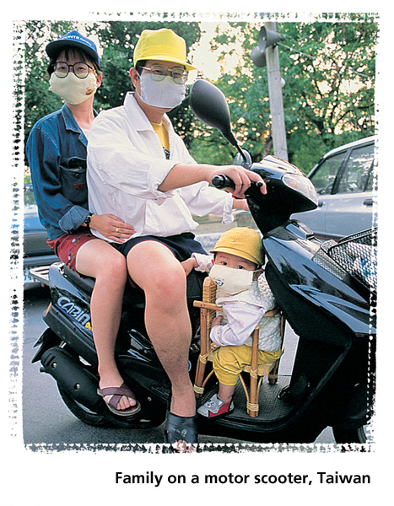
A Geographic View

Slide 29
Geographic Literacy
During the 1990s alone, more than 12,000 people were killed in earthquakes in East Asia. Nearly half of these deaths occurred in 1995 in Kobe, Japan, where an earthquake measuring 6.7 on the Richter scale struck. An increase of one whole number on the Richter scale means a tenfold increase of the earthquake’s force; thus, a 6.7 earthquake is 10 times stronger and more damaging than a 5.7 earthquake.

Slide 30
The Power Dilemma
Rising standards of living and growing economies have resulted in greatly increased demands for electric power in East Asia.
Fossil Fuels
Most of East Asia’s power comes from the burning of fossil fuels.
China, North Korea, and Mongolia are able to rely on their coal reserves for power, but Japan, South Korea, and Taiwan have few coal or oil deposits and must import fossil fuels.
Aware of the damage that fossil fuels inflict on the environment, East Asians have begun to search for cleaner sources of power.
China’s Three Gorges Dam project on the Yangtze River aims to supply a huge amount of hydroelectric power to China’s interior.

Slide 31
The Power Dilemma
Nuclear Energy Japan, South Korea, and Taiwan rely on nuclear energy for 30 to 40 percent of their electrical power.
Accidents at nuclear power plants have caused Japan to look for safer sources of power.
Since 1999 the country has opened several plants that generate wind and solar energy.

Slide 32
Environmental Concerns
East Asians largely ignored environmental problems during the region’s period of industrial and economic growth. Only now are the countries of East Asia beginning to deal with these challenges.

Slide 33
Environmental Concerns
China
Nine of the 10 most-polluted cities in the world are located in China.
One major cause is China’s heavy reliance on coal, which causes smog (a combination of smoke and fog) and acid rain.
In northern industrial areas, windblown dust adds to the air pollution, causing lung disease among many people living there.
Neighboring countries, such as Japan, also are affected by China’s acid rain.
Eighty percent of China’s cities have no sewage treatment facilities.
Sewage, as well as industrial waste from factories, poses health risks to urban populations.
Regarding another issue–deforestation–China has tried to remedy the clear-cutting of forests by planting more trees.

Slide 34
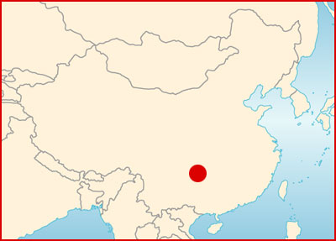
Environmental Concerns

Slide 35
Environmental Concerns
North Korea, South Korea, and Taiwan South Korea relies on nuclear energy and is faced with the problem of radioactive waste.
North Korea’s industrial pollution has resulted in unsafe drinking water.
Taiwan also suffers from water and air pollution.

Slide 36
Environmental Concerns
Mongolia Mongolia faces problems of deforestation, overgrazing, and pollution from burning fossil fuels.
Japan Leads the Cleanup Japan ignored the effects of its industrial growth on the environment for a long time.
Since the 1970s, however, Japan has developed some of the world’s strictest environmental laws.
Japan has developed a program to help stop global warming and has offered financial help and “clean technology” to other East Asian countries.
In 1990 Japan mandated the use of less-polluting vehicles and overall waste reduction.
Unfortunately, Japan’s carbon dioxide emissions actually rose during the 1990s.

Slide 37
Managing Ocean Resources
Commercial fishing is a major industry in China, Japan, and South Korea.
Overfishing, however, has become a serious problem, and Japan now imports large quantities of seafood.
Several countries have developed large factory ships to fish far out in international waters.
Because of overfishing, international pressure has increased to curb this practice.
Whales are a delicacy in Japan.
Despite a 1986 international treaty limiting whaling, Japanese fleets continue to hunt whales, including endangered species.

Slide 38
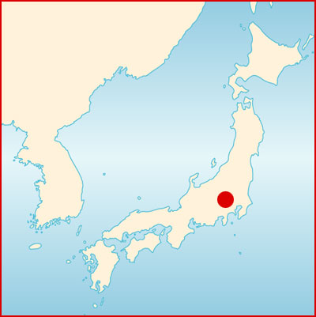
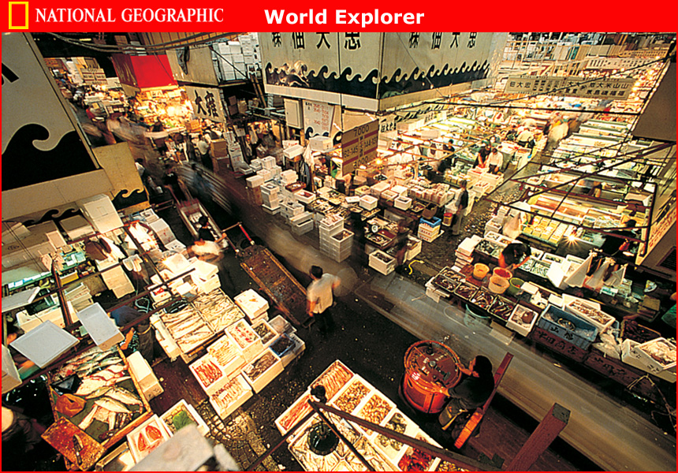
Managing Ocean Resources

Slide 39
Natural Disasters
Flooding is a serious problem along the Yellow and Yangtze Rivers.
China is working on more flood-control projects, including the controversial Three Gorges Dam on the Yangtze River.
Most of East Asia is prone to earthquakes.
About 1,500 small earthquakes shake Japan each year.
Japan has more than 80 active volcanoes.
Underwater volcanoes can cause tsunamis.
Periodic typhoons damage areas near the coasts.

Slide 40
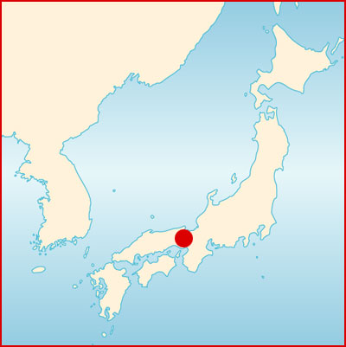
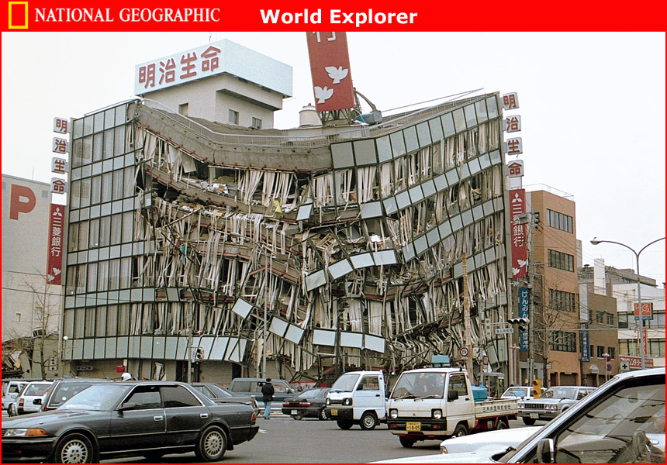
Natural Disasters

Slide 41
Section 1 – Summary
East Asian economies include market and command systems, as well as a mix of both.
East Asia was once mainly agricultural, but trade and industry have brought prosperity and economic growth to most of its countries.
Most Chinese work in agriculture, although industry and commerce are thriving in certain areas as a result of government-sponsored economic reforms.
Japan is East Asia’s leading industrial country, followed by Taiwan and South Korea.
Trade and business investments bring together capitalist and communist countries in East Asia.

Slide 42
Section 2 – Summary
Rapid industrial growth in East Asia has caused environmental challenges that were ignored for decades.
Japan, with its strict anti-pollution laws, has become a leader in protecting and cleaning up the environment.
China’s economic development and the needs of its large population have a decisive impact on the environment.
East Asia is subject to natural disasters such as flooding, earthquakes, tsunamis, and typhoons.
Human activities in East Asia–such as clearcutting forests, farming, and mining–have caused environmental disasters such as erosion, desertification, and flooding.

